Slide 1



AI-DRIVEN JOB INTERVIEW ANALYZER
Short Title: Interview Den (S25-47-D)
Team: Hamza Saeed 21i-0671
Waleed Saeed 21i-1672
Asad Ullah Shah 21i-0545
Supervisor: Dr. Mehreen Alam

Slide 2
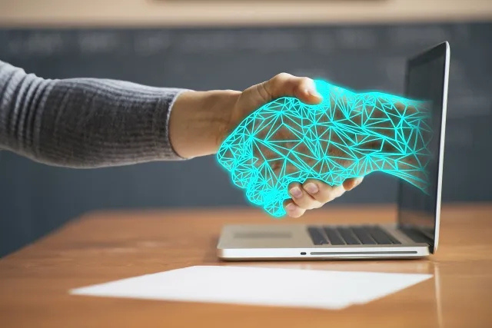
Project Overview

Slide 3
Type of Project: Development
Company Name: Developers Den
Project Focus:
The AI-Driven Job Interview Analyzer aims to automate and optimize the hiring process by leveraging AI for resume screening, skill assessments, and AI-conducted interviews. It provides an efficient, unbiased, and transparent evaluation system for both companies and candidates, reducing hiring time and improving decision-making.

Slide 4
Hiring is slow, biased, and inefficient, with manual resume screening and lengthy interviews delaying talent acquisition. Candidates also face uncertainty due to a lack of timely feedback. An AI-driven solution is needed to automate screening, assessments, and interviews, ensuring a faster, fairer, and more effective hiring process.
Problem Statement

Slide 5
Hiring the right talent is time-consuming and often inefficient, with recruiters overwhelmed by resumes and candidates facing uncertainty. We believe hiring should be faster, fairer, and smarter. By leveraging AI, this project aims to reduce bias, speed up hiring, and provide a transparent experience for both employers and job seekers.
Motivation

Slide 6
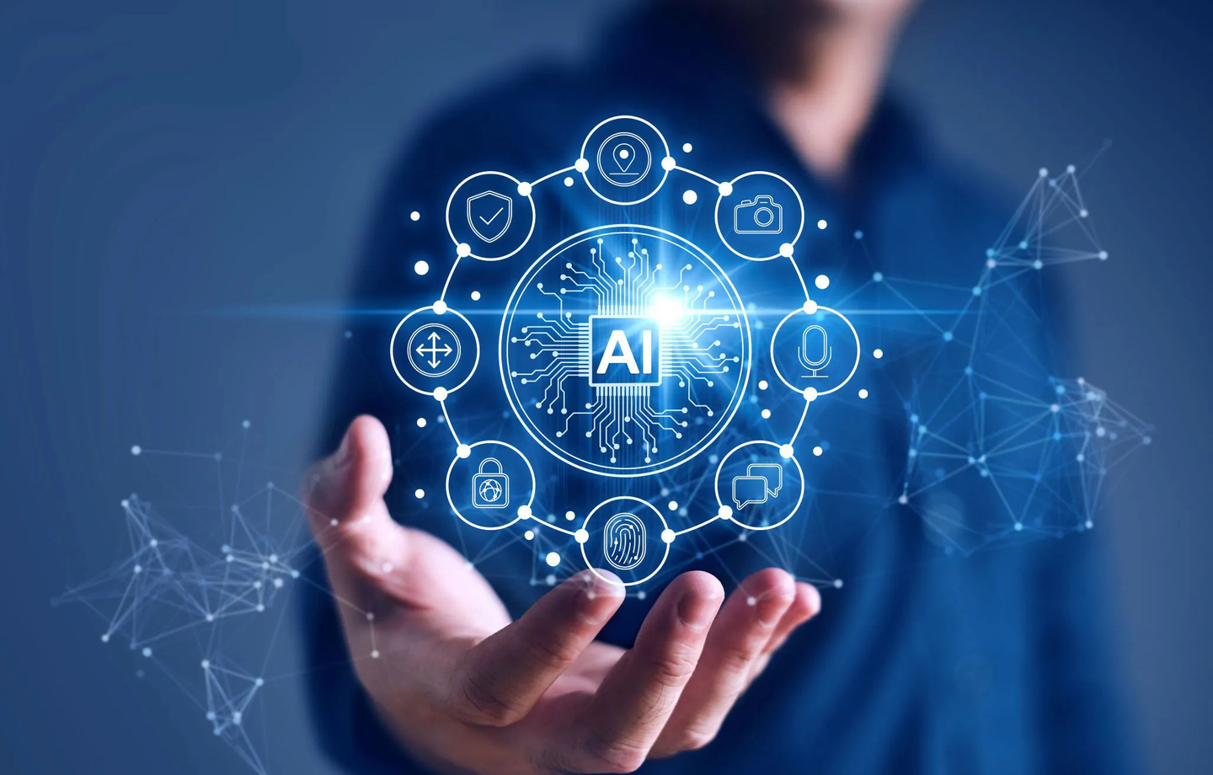
Project Scope

Slide 7
1. AI Resume Screening
Objective: Automate resume evaluation for efficient job matching.
Implementation Options:
Standardized Parsing: Convert various CV formats into a structured template for analysis.
GPT-Based Parsing: Use LLMs to extract and assess key data points from resumes.
Scoring & Fraud Detection:
Assign a CV Score based on job requirement fulfillment.
Detect inconsistencies and potential fraud in resumes.

Slide 8
2. AI Test Creation
Objective: Generate dynamic, AI-powered tests customized to job roles.
Features:
AI-generated customized questions based on job descriptions.
Option for companies to add their own questions and set difficulty levels.
Test Stages (Tentative):
Basic Aptitude – General knowledge assessment.
Technical Questions – Role-specific skills evaluation.

Slide 9
3. AI Interview & Test Monitoring
Objective: Ensure fair, real-time evaluation through AI-assisted monitoring.
Features:
Real-time test proctoring and AI-based response analysis.
Evaluate technical, communication, and soft skills for a holistic assessment.

Slide 10
4. AI-Based Scoring & Insights
Objective: Provide an unbiased, transparent evaluation process.
Scoring Components:
Resume Screening – CV relevance scoring.
Quiz & Technical Test – Knowledge and skills validation.
AI Interview – Communication and problem-solving assessment.
Customization & Reporting:
Companies can prioritize specific criteria (skills, experience, location, etc.).
Visualized recruitment pipeline with detailed reports for hiring decisions.

Slide 11
Portals

Slide 12
Expected Outcomes

Slide 13
Uses and Impact

Slide 14
Timeline

Slide 15
Tools

Slide 16
Thank you!
Any Questions?

